Slide 1

The OpenStreetMap Revolution
building community one node at a time
This document licensed in entirety by Creative Commons CC-by-SA. For specific terms of license, see: http://creativecommons.org/licenses/by-sa/3.0/

Slide 2
Overview
The Short History of the OpenStreetMap Revolution
Why OpenStreetMap has reached the tipping point
Why volunteer mappers are a valuable resource for your community
How you can get involved

Slide 3
The Origins of OpenStreetMap
OpenStreetMap.org domain registered by Steve Coast in 2004
Project originated in the United Kingdom, where…
Crown copyright on geospatial data
Little, or no public domain data
Simple goal to create a free, publicly-available database of street centerlines

Slide 4
OpenStreetMap is…
A freely-editable map of the world unconstrained by proprietary ownership
“Wikipedia for maps”

Slide 5
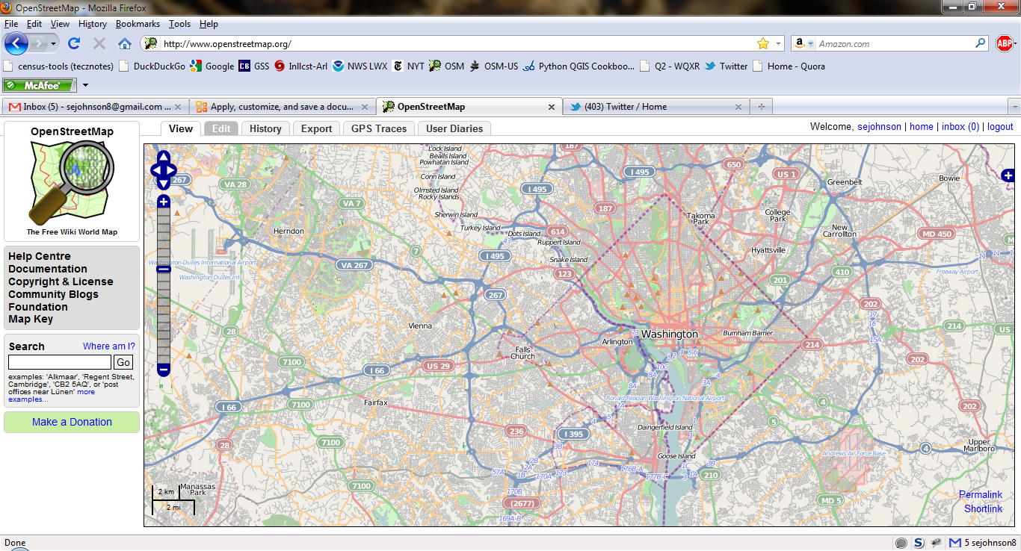
Looks like…a wiki

Slide 6
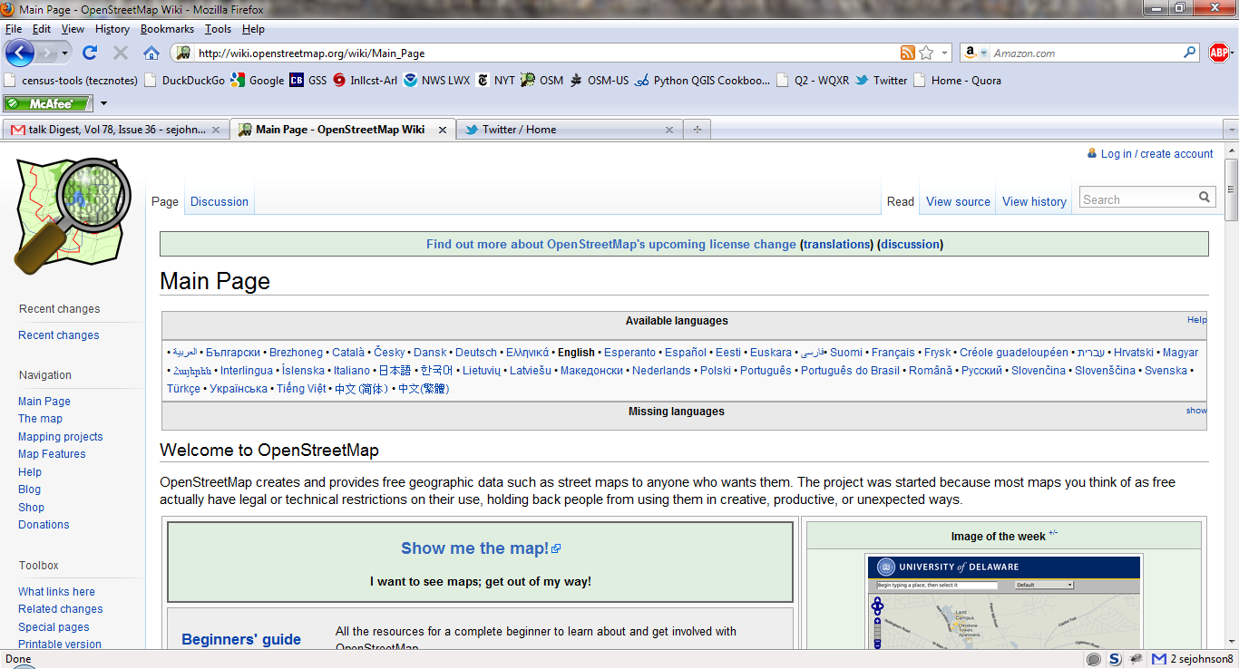
Wiki-based Documentation!

Slide 7
Milestones in OpenStreetMap History
2004 - OpenStreetMap.org registered by Steve Coast
2005 – Map Limehouse, 1st OpenStreetMap mapping party
2005 – 1000 registered OpenStreetMap users
2006 – OpenStreetMap Foundation established
2007 – 5 million ways in OSM database
2007 – 10,000 registered OpenStreetMap users
2008 - TIGER data import for the US completed
2009 - 100,000 registered OpenStreetMap users
2010 - 200,000 registered OpenStreetMap users
2011 – 400,000 registered OpenStreetMap users

Slide 8
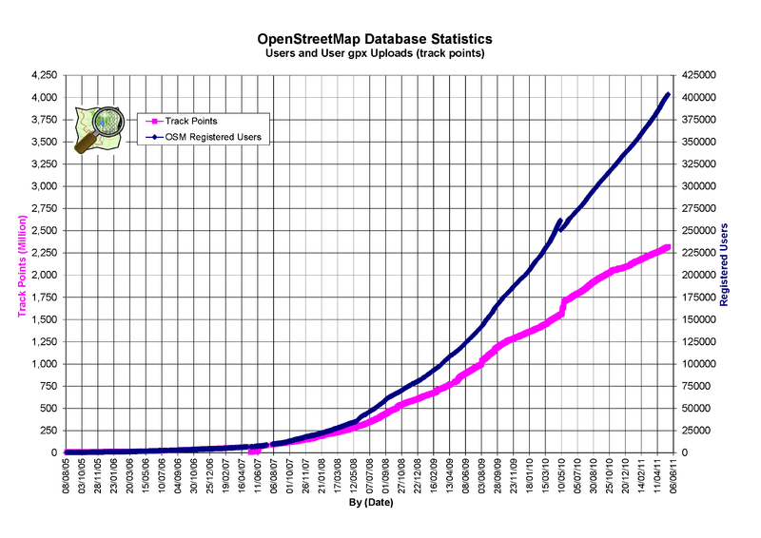
OpenStreetMap User Growth

Slide 9
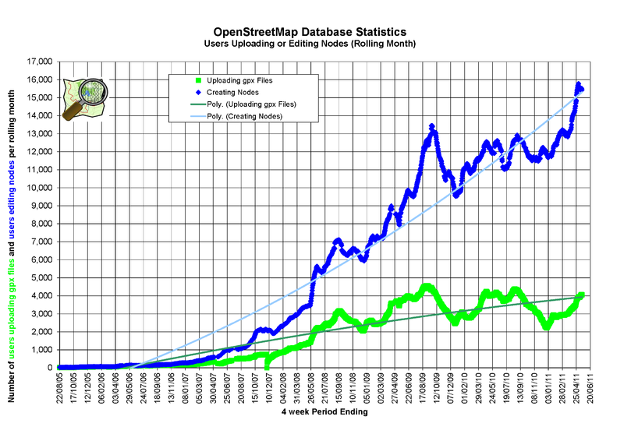
OpenStreetMap Growth in User Edits

Slide 10
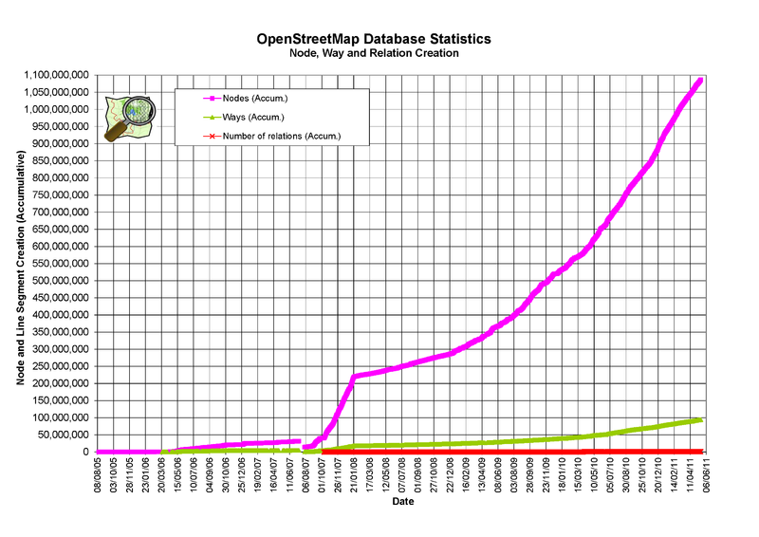
OpenStreetMap Database Growth

Slide 11
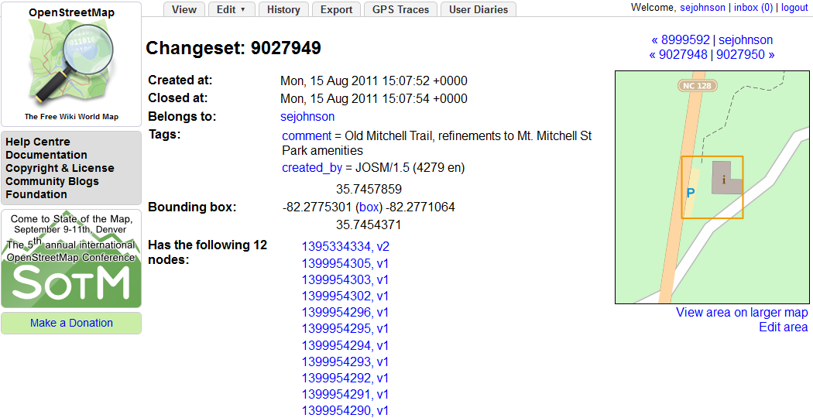
Data Model
Every edit is part of a Changeset

Slide 12
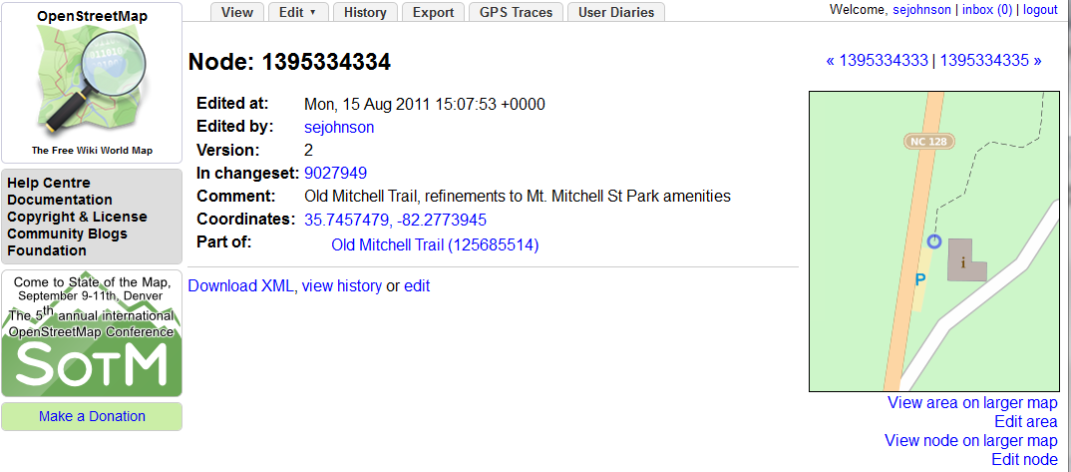
Data Model
Every Changeset is composed of Nodes

Slide 13
Data Model
Every node has an XML representation
<osm version="0.6" generator="OpenStreetMap server"><node id="1395334334" lat="35.7457479" lon="-82.2773945" changeset="9027949" user="sejohnson" uid="25398" visible="true" timestamp="2011-08-15T15:07:53Z" version="2"/>
</osm>

Slide 14
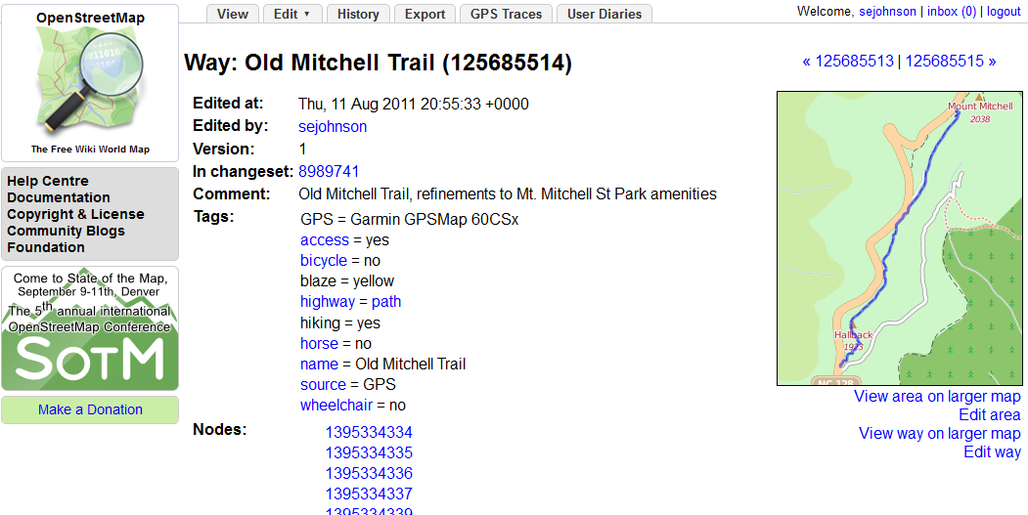
Data Model
Nodes are ordered into Ways

Slide 15
Q. Where did all this data come from?
A. Mapping Parties

Slide 16
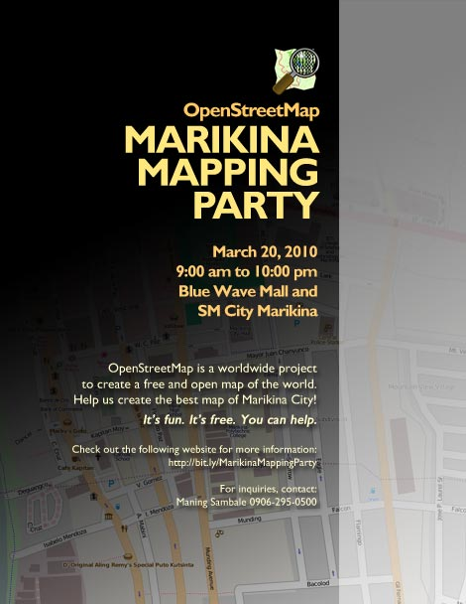
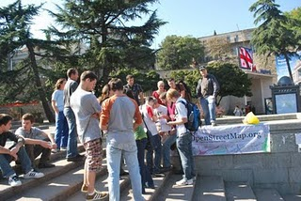
Mapping Party?
Informal get together
Do some mapping
Socialize & make friends
Make a free map of the world!

Slide 17
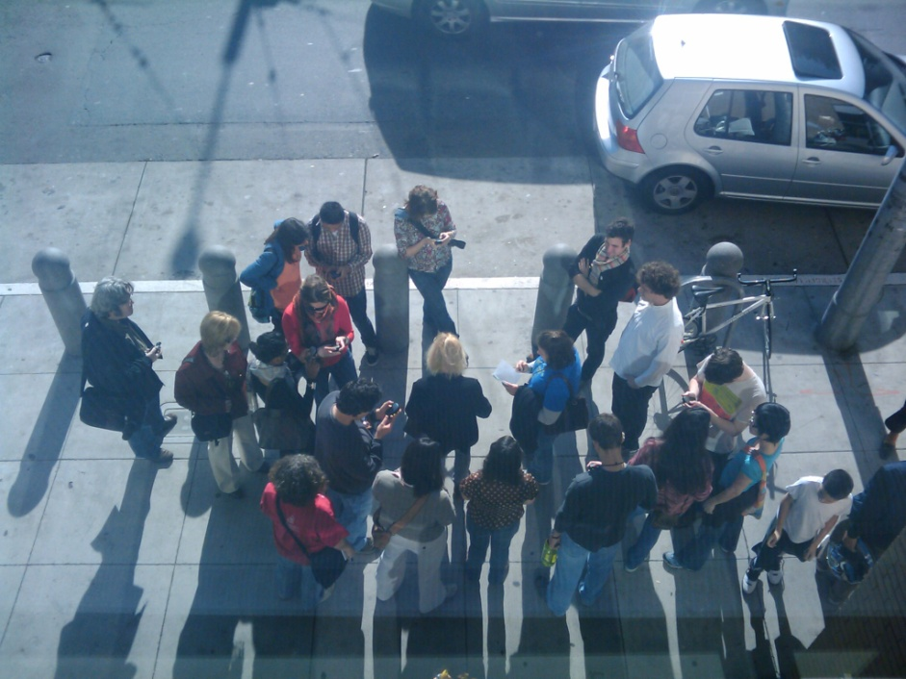
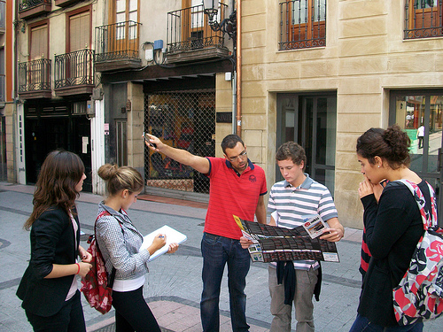
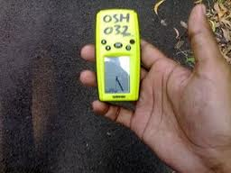
Mapping Party? Yes!
It’s a community event
Organized around mapping a local area
Collect Data
Upload and tag
Socialize

Slide 18
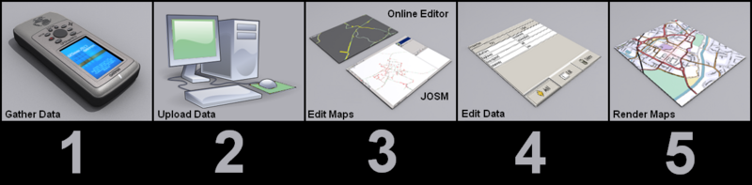
Mapping Party Workflow Overview
1 Gather data
2 Upload GPS tracks
3 Trace the features
4 Tag with attributes
5 View results
Source: http://wiki.openstreetmap.org/wiki/Map_Making_Overview

Slide 19
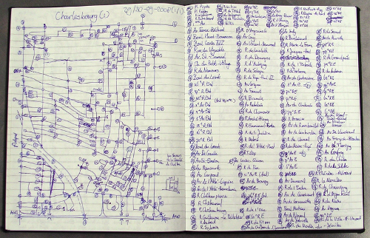
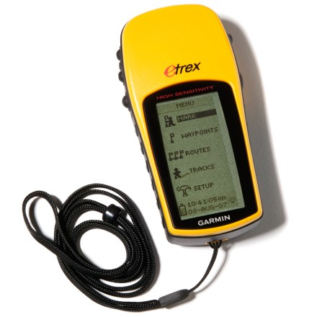
Step 1. Collecting Data
What features will you map?
Local businesses?
Street furniture?
Street trees?
Add addresses to building
footprints?
Local knowledge is a plus
Take notes in the field
Source: Frank’s Log Book http://weait.com/content/look-frank-log-book
Source: Garmin

Slide 20
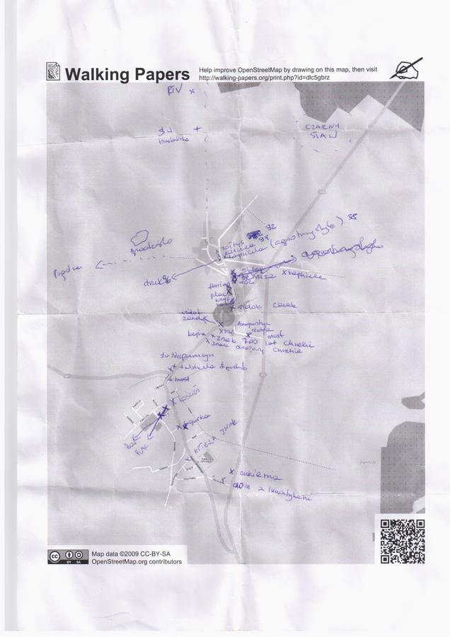
Step 1: Collecting Data: On Paper
Walking-papers.org from Stamen Design
Zoom to area of interest
Create .pdf
Print and use in the field.
Use heads-up digitizing and imagery to input data into OSM
Source: http://walking-papers.org/

Slide 21

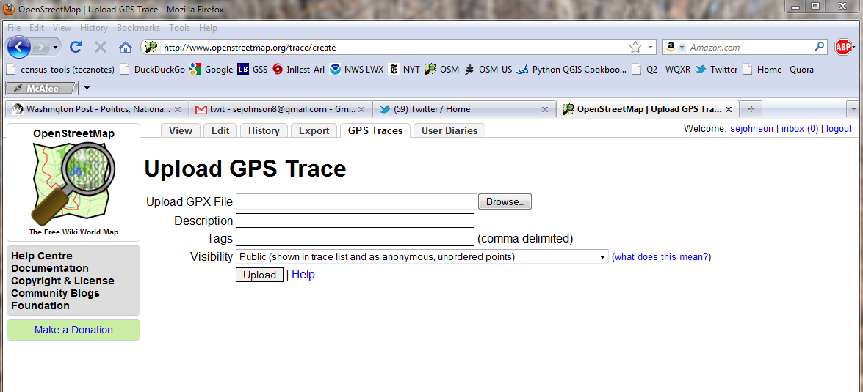
Step 2. Upload GPS data to OSM
Login to OSM
Copy data from GPS unit
Click ‘GPS Traces’ tab, then click ‘Upload a Trace’

Slide 22
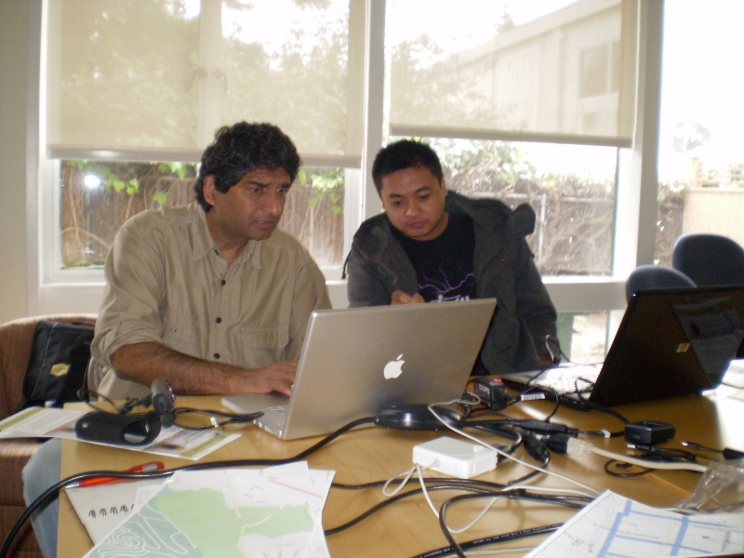
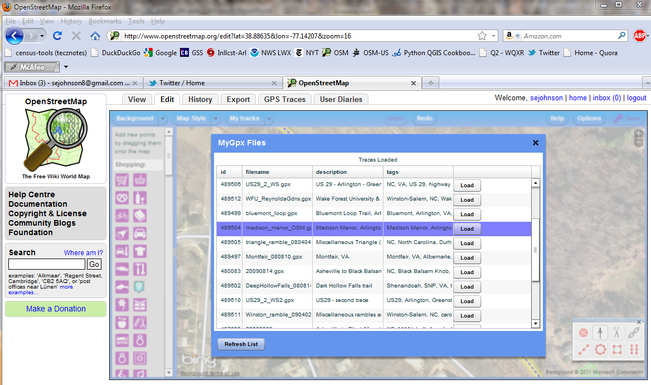
Step 3. Edit the Traces to Map Features
Use your favorite editor to trace the GPS tracks into OSM
Source: Cloudmade.com

Slide 23
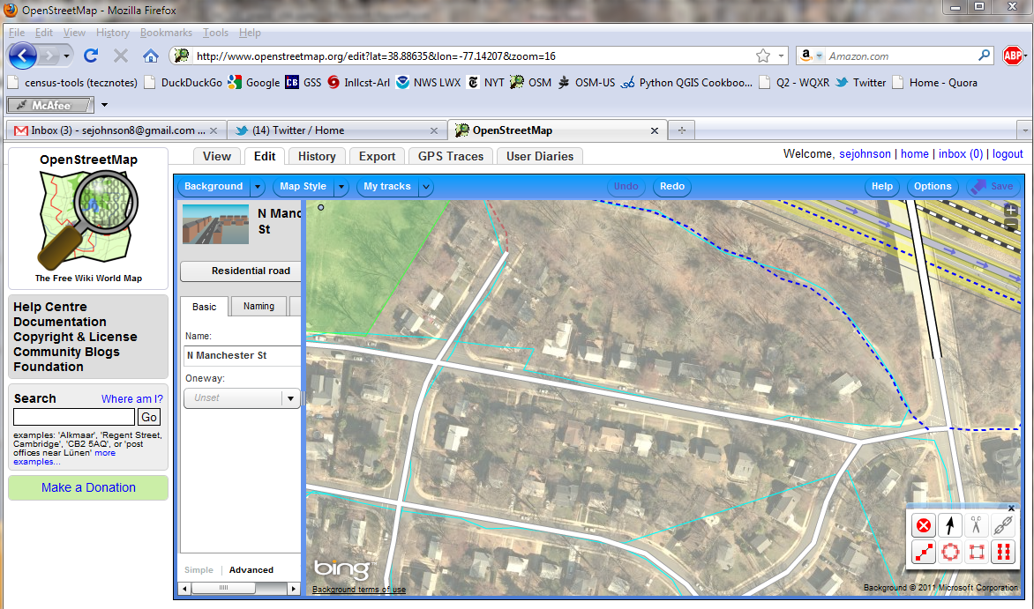
Step 3. Edit the Traces (cont’d.)
Imagery backdrop allows for smoothing of GPS data

Slide 24
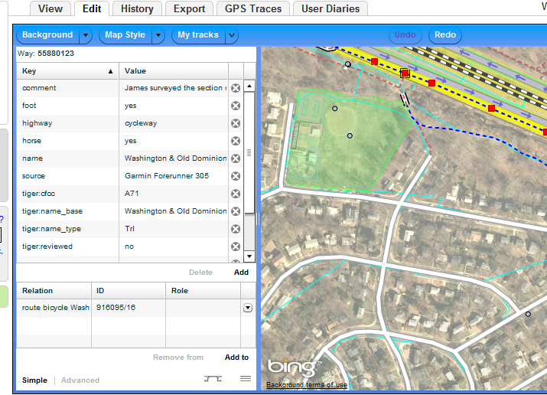
Step 4. Tag the Features to Add Data
‘Tag’ = ‘add attribute data’
Take the form of Key + Value

Slide 25
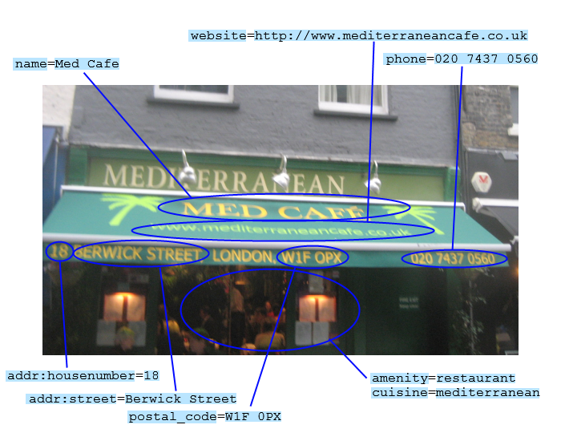
Step 4: Tagging (cont’d.)

Slide 26
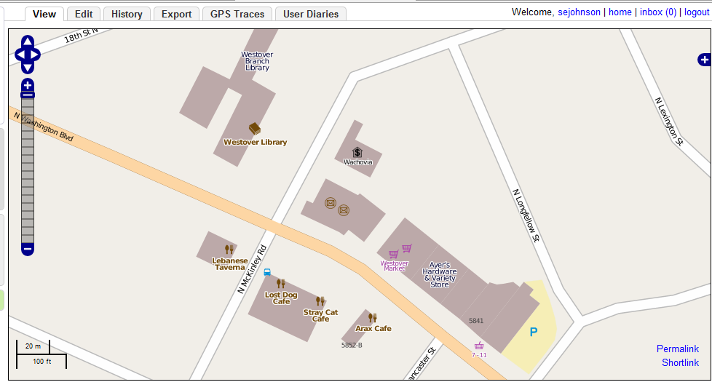
Step 5. Admire Your Work
Results usually available within an hour of uploading

Slide 27
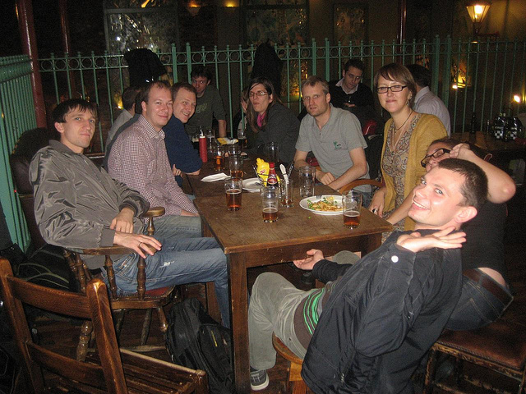
Adjourn to Mappy Hour!
Source: Flickr, user Harry Wood

Slide 28
Summary
Seven years of continuous growth
Over 400, 000 users distributed worldwide
Maturing methods of data input
Increasingly comprehensive
Auditable RESTful data model

Slide 29
Why OpenStreetMap is at a Tipping Point
services built on OpenStreetMap

Slide 30
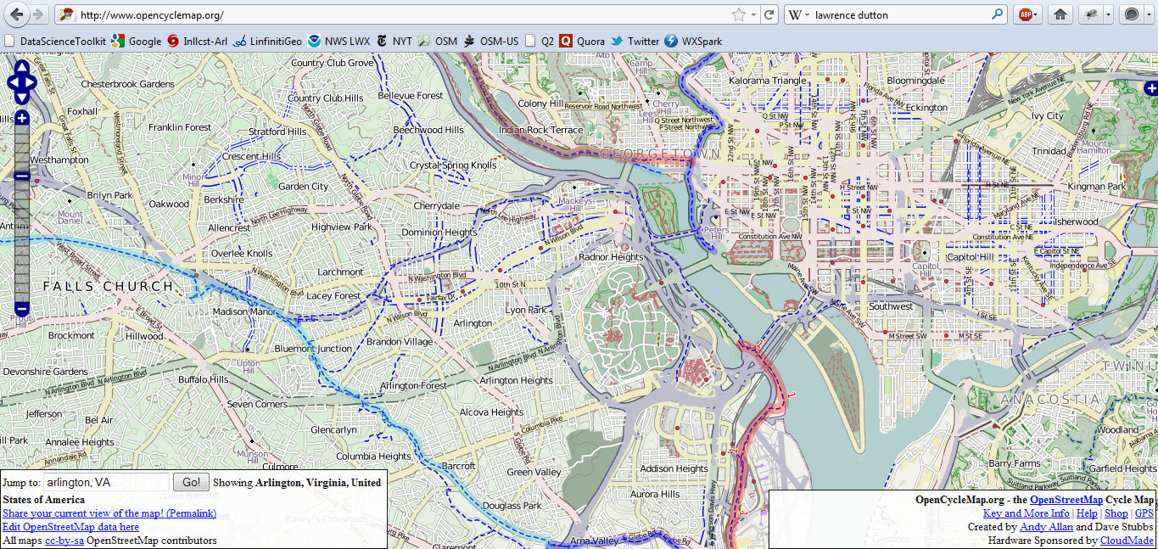
OpenStreetMap as a platform for services
OpenCycleMap – Map of Bicycle Routes

Slide 31
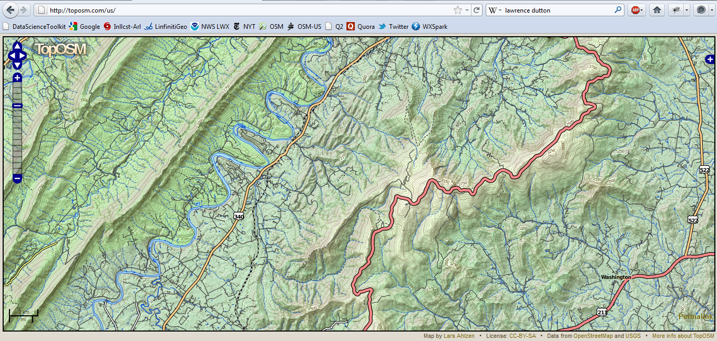
OpenStreetMap as a platform for services
TopOSM – Topographic OpenStreetMap

Slide 32
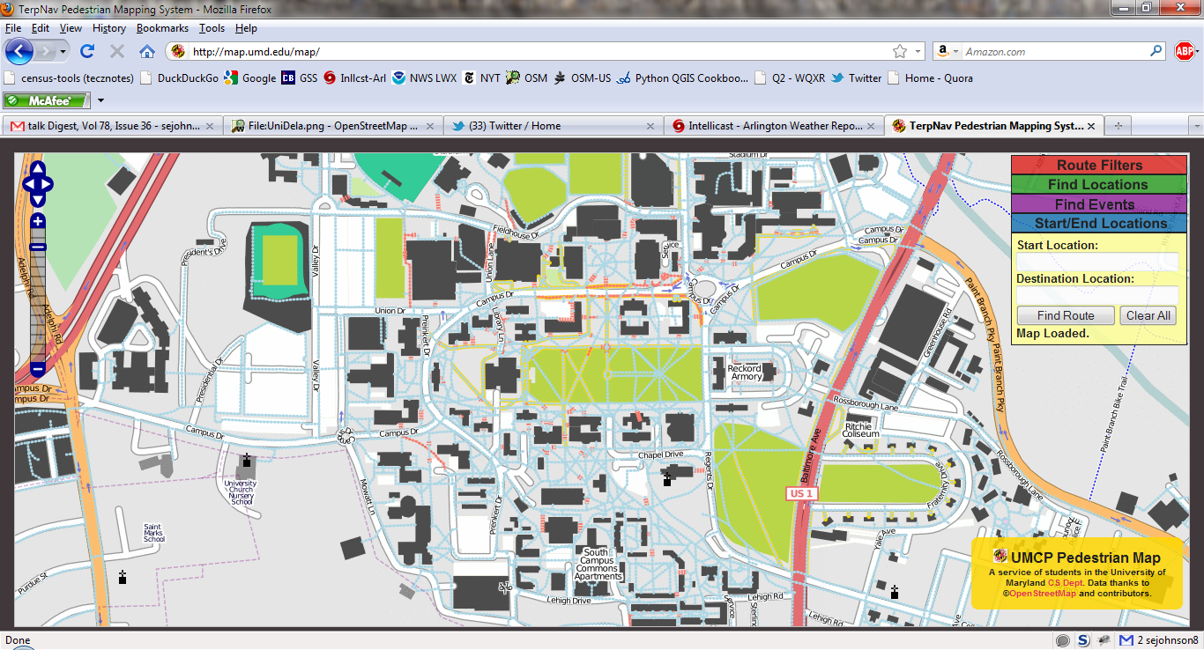
OpenStreetMap as a platform for services
University of Maryland Campus Map

Slide 33
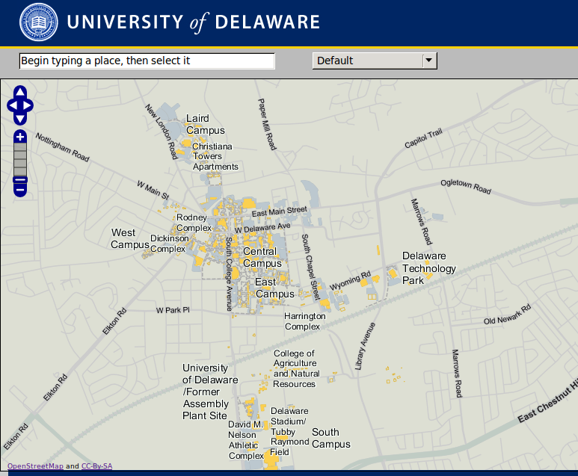
OpenStreetMap as a platform for services
University of Delaware on OpenStreetMap

Slide 34

OpenStreetMap as a platform for services
MapQuest Open Tools:
Names (Gazetteer)
APIs & SDKs
Tiles
Beginner’s Guide to OpenStreetMap
http://developer.mapquest.com

Slide 35
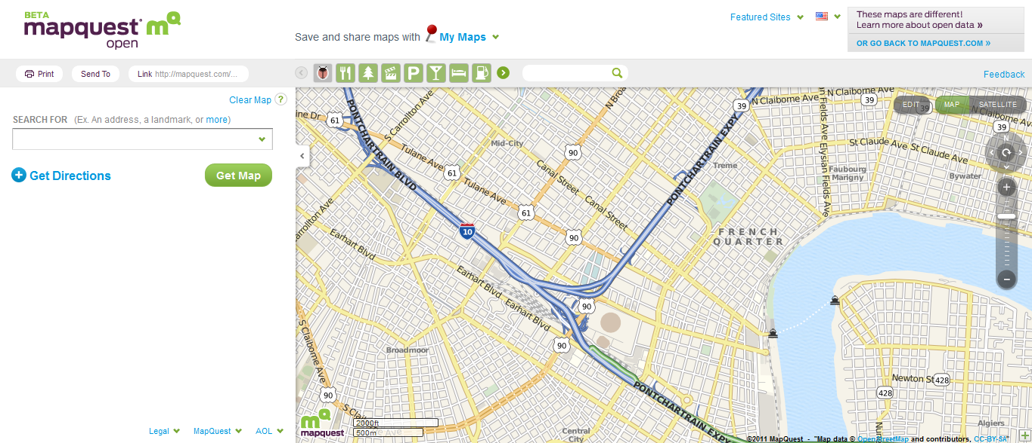
OpenStreetMap as a platform for services
MapQuest Open, using & editing OSM

Slide 36
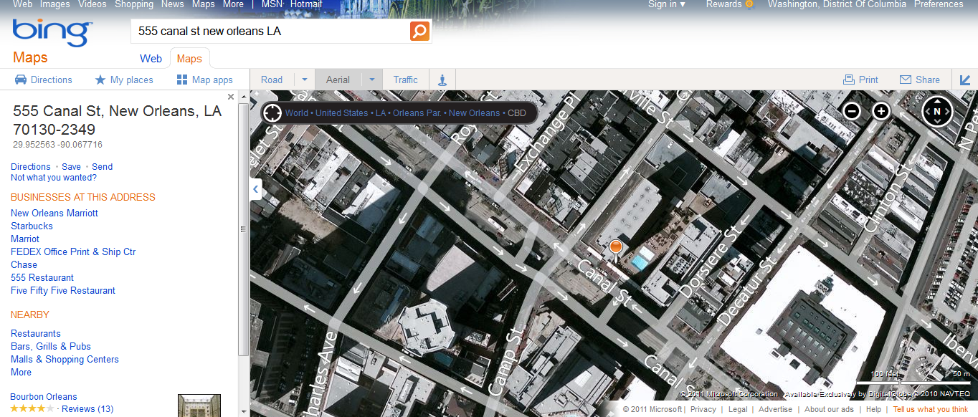
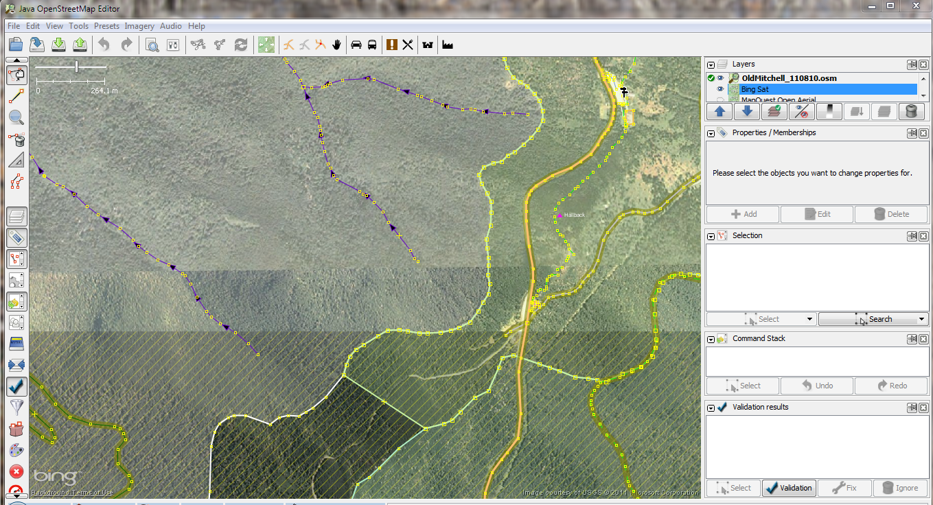
OpenStreetMap as a platform for services
Bing Imagery in Java OpenStreetMap Editor

Slide 37
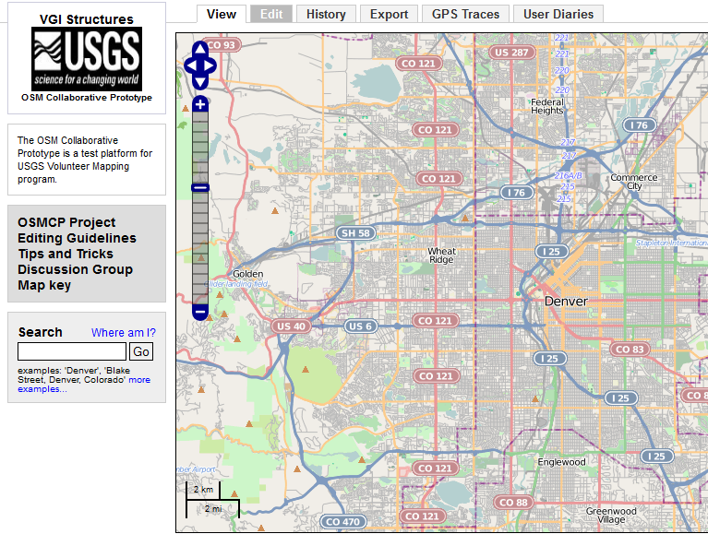
US National Map prototype
Can crowdsourced data meet or exceed standards for integration into National Map?
Test the OSM platform for use in National Map applications
Test decentralized platform to improve Federal data

Slide 38
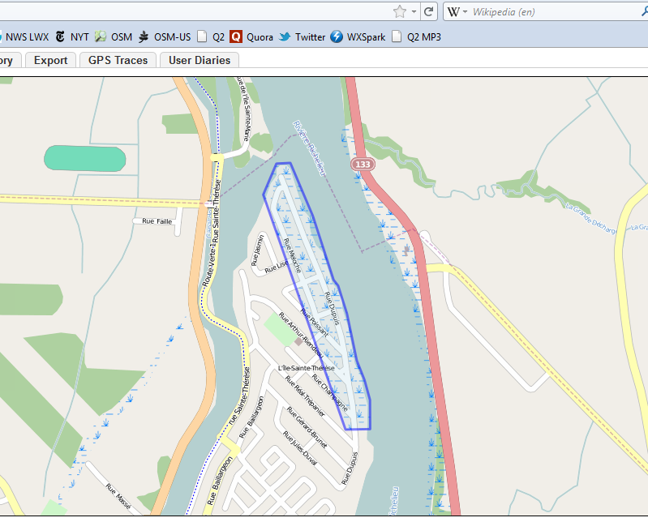
Humanitarian OpenStreetMap Team
Established after Haiti Earthquake 2010
Operates where maps are scarce or out-of-date
Geared to humanitarian response and economic development

Slide 39
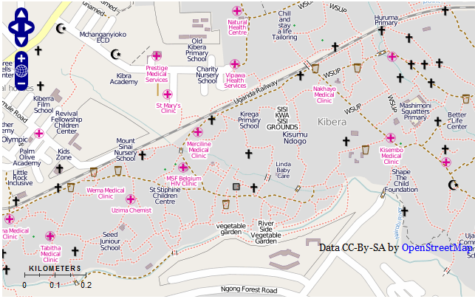
Map Kibera Project
Informal settlement in Nairobi, Kenya
Not on any map until Nov ‘09
Now a complete interactive community information project.

Slide 40



Tools for Data Quality
Mapdust
OSM Mapper from ItoWorld
MapCompare from GeoFabrik
OSM Inspector from GeoFabrik

Slide 41
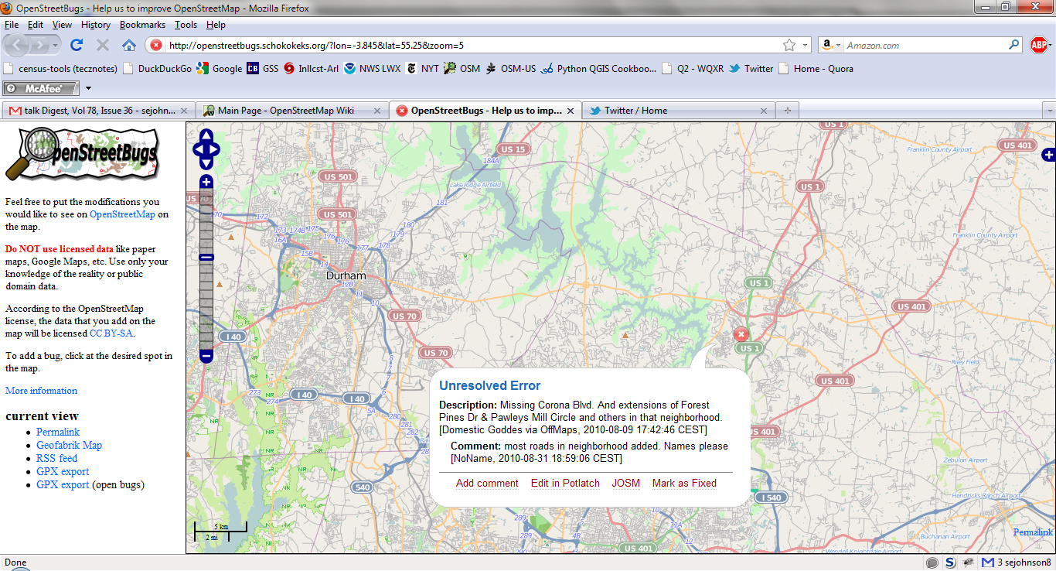
Tools: OpenStreetBugs

Slide 42

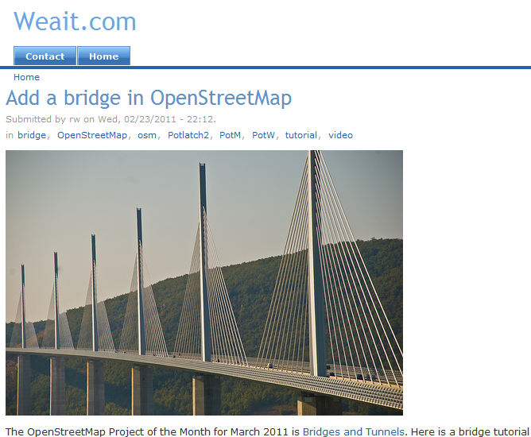
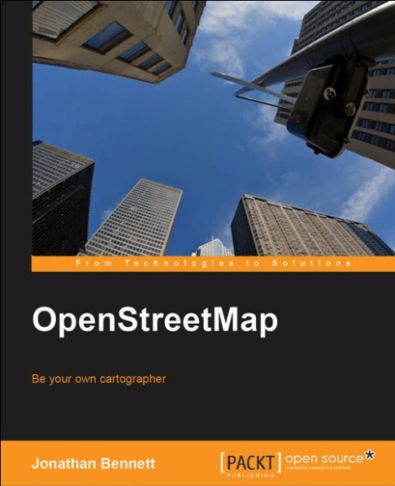
OSM Instructional Materials
Tutorials at Weait.com
Books by
Jonathan Bennett
Frederik Ramm, Jochen Topf, Steve Chilton

Slide 43
Why is OpenStreetMap at a tipping point?
There are a growing number of services built around OpenStreetMap
Commercial
Non-governmental
Government
There are more utilities for data quality and data manipulation
Maturing community of users, resources, documentation

Slide 44
What is the Value of Citizen Mapping?
Putting Openstreetmap in perspective

Slide 45
Citizen Mapping, pre-OpenStreetMap
Denis Wood, North Carolina State University, geographer, landscape architect
Began creation of a neighborhood atlas in 1975
Mapped his neighborhood of Boylan Heights, Raleigh, NC
Set a goal of creative mapping
What things of interest are not on the official maps?

Slide 46
Citizen Mapping, pre-OpenStreetMap
See, and map those things unique to a place:
Map the overlooked – Utility poles, Potholes
Map the seemingly insignificant – Street trees, Informal Paths
Ephemeral Events – Graffiti, Street Fairs
What if users could engage in Creative Cartography?

Slide 47
Citizen Mapping, pre-OpenStreetMap
“I might help my students learn something about how to read the landscape by focusing hard on a small piece of it.”
-- Denis Wood
Source: http://makingmaps.net/2008/01/10/denis-wood-a-narrative-atlas-of-boylan-heights/

Slide 48

Denis Wood’s Boylan Heights Maps
Streetlights in Boylan Heights
Source: http://makingmaps.net/2008/01/10/denis-wood-a-narrative-atlas-of-boylan-heights/

Slide 49
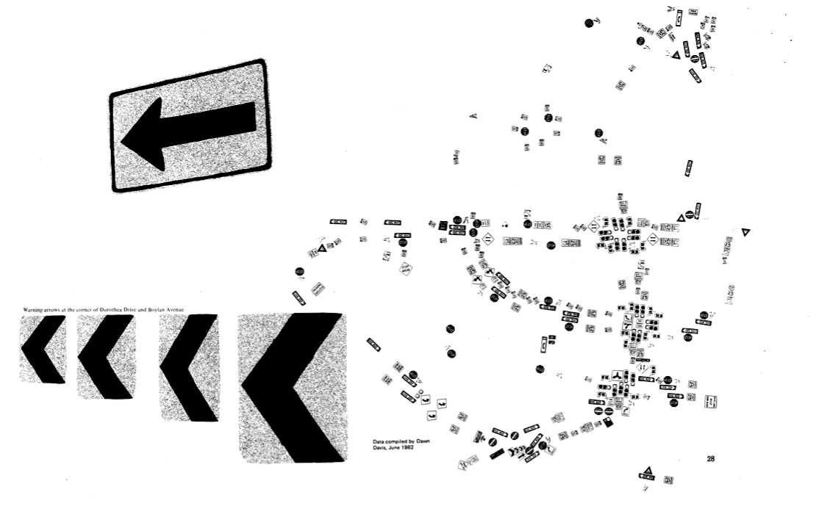
Denis Wood’s Boylan Heights Maps
Street signs in Boylan Heights
Source: http://makingmaps.net/2008/01/10/denis-wood-a-narrative-atlas-of-boylan-heights/

Slide 50
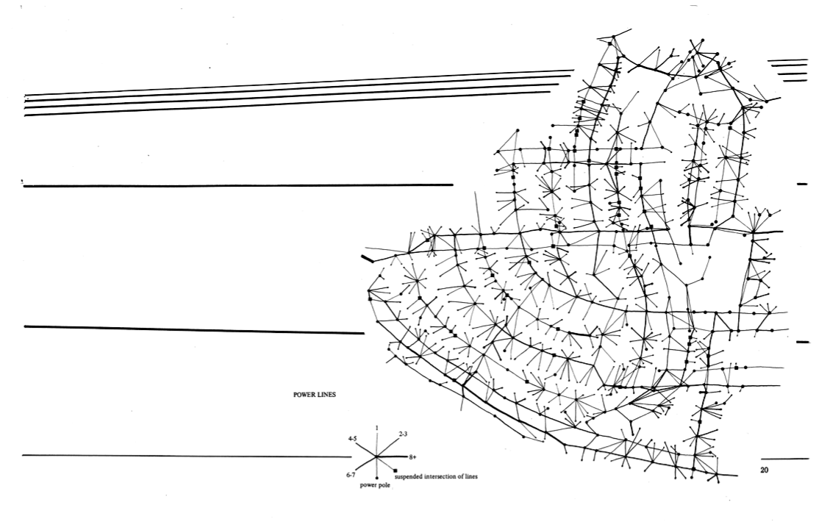
Denis Wood’s Boylan Heights Maps
Power Lines and Utility Poles
Source: http://makingmaps.net/2008/01/10/denis-wood-a-narrative-atlas-of-boylan-heights/

Slide 51
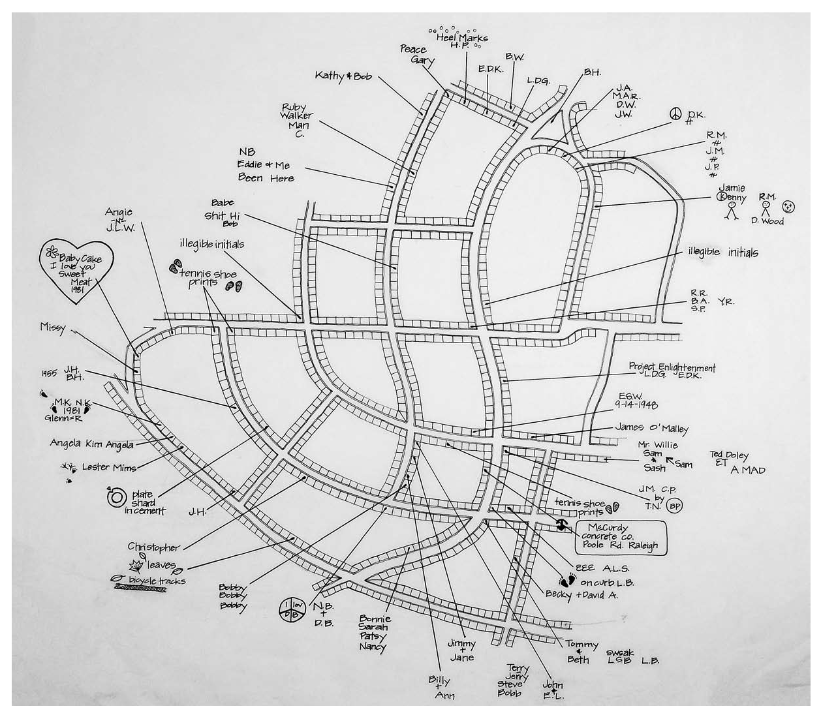
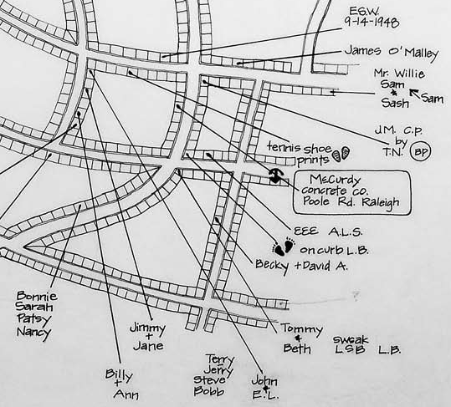
Denis Wood’s Boylan Heights Maps
Graffiti & Tags

Slide 52
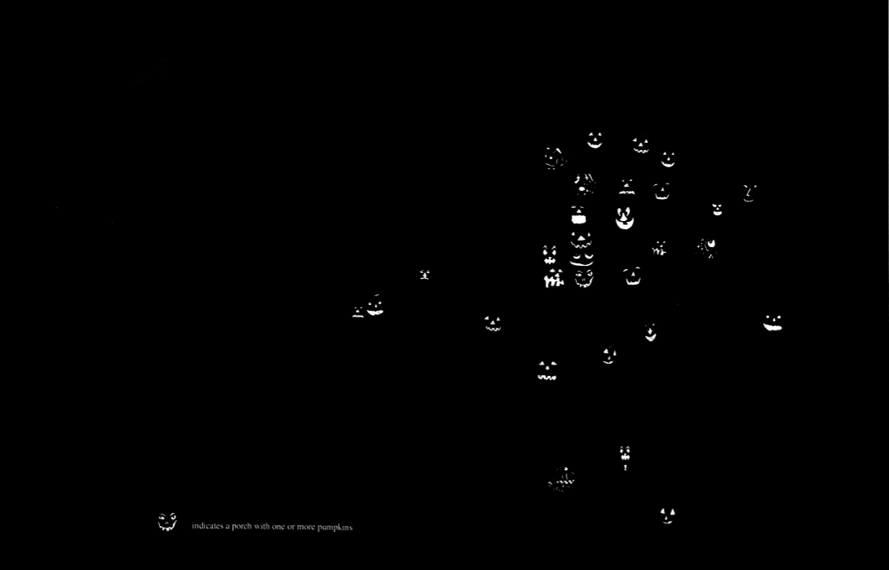
Denis Wood’s Boylan Heights Maps
Jack O’Lanterns in Boylan Heights
Source: http://makingmaps.net/2008/01/10/denis-wood-a-narrative-atlas-of-boylan-heights/

Slide 53
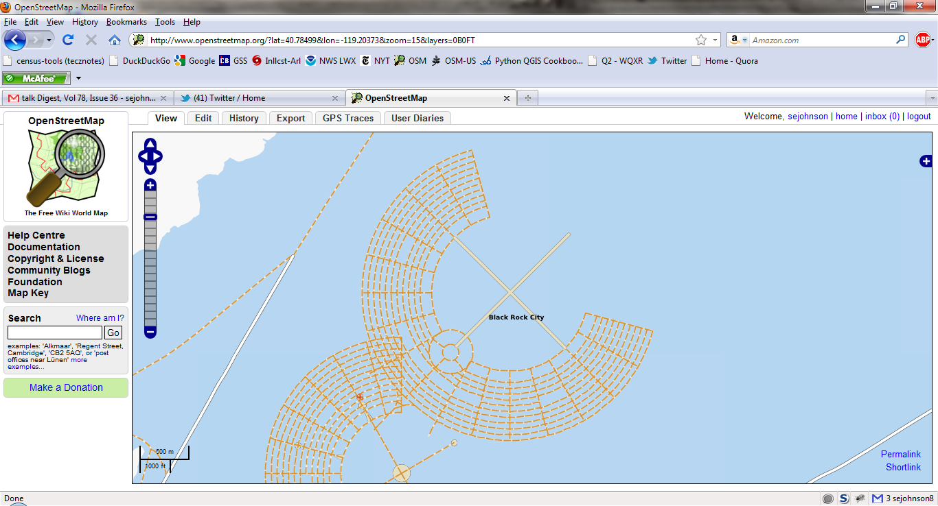
Burning Man, 2007 & 2008
Can the Bureau of Land Management find this information elsewhere?

Slide 54
Making local knowledge visible
“…we also wanted to use the mapping as a kind of organizational tool, as a way of bringing the neighborhood together and helping it to see itself.”
– Denis Wood
Give community identity a cartographic representation
Mapping to make local knowledge manifest
Mapping the vernacular landscape, the landscape of the everyday
Source: http://makingmaps.net/2008/01/10/denis-wood-a-narrative-atlas-of-boylan-heights/#more-106

Slide 55
How does OpenStreetMap contribute to Sense of Community?
OpenStreetMap validates Denis Wood’s observations about mapping at the human scale:
A mapping party forces participants to interact with geography on a personal level
Contributing to OpenStreetMap produces understanding of community
OpenStreetMap enables people to build community identity

Slide 56
Building a Community of Mappers
how can you Make Use of OpenStreetMap

Slide 57
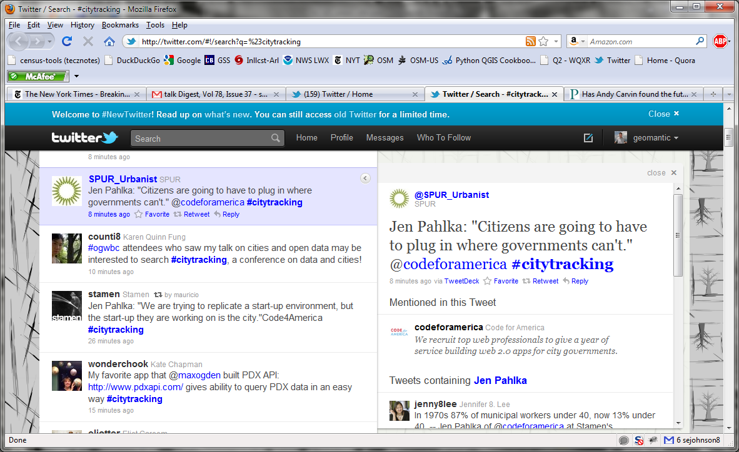
Can governments collect all data of interest?

Slide 58
Professional Amateurs
The critical difference between professionals and amateurs used to be access to the tools and training.
The Internet…
…has provided the tools and training
…has enabled “mass amateurization”
…has enabled “extreme citizen science”
In short, the Internet has helped close the gap between professional and amateur

Slide 59
The Web has shifted the way we do things
Web GIS
2001
2011
Geospatial Web
It’s the map!
Client-Server
Analysts
Geo-priesthood
Data integration layers
GIS platform
Features with attributes
It’s the task!
Loosely coupled
Users and stakeholders
Mass Amateurization
Data fusion on the fly
Extensible infrastructure
Data linked to features

Slide 60
Web-based democratization of mapping
Centralized to Decentralized
Proprietary systems to Open Source
“Wisdom of the Crowds” (James Surowecki)
“Folksonomy” vs. Experts
Wikipedia vs. Britanica
Compare OSM to NAVTEQ
$396M maintaining database
270 employees in central facility
700 analysts worldwide (2007)

Slide 61
If anyone can map, what about quality?
Can I trust OpenStreetMap data?
Is it accurate?
Is it complete?

Slide 62
Authority and Trust
“…participants have a lot of respect for the knowledge of the scientists, as long as the scientists have a lot of respect for the knowledge and ability of the participants.”
“The participants would like to learn more about the topic that they are exploring and are keen to know: ‘what does the data that I collected mean?’”
--Muki Haklay
Source: http://povesham.wordpress.com/2010/01/29/haiti-%E2%80%93-further-comparisons-and-the-usability-of-geographic-information-in-emergency-situations/

Slide 63
Authority and Trust
“…at some point, they are becoming knowledgeable participants and it is worth seeing them as such.”
-- Muky Haklay
Source: http://povesham.wordpress.com/2010/01/29/haiti-%E2%80%93-further-comparisons-and-the-usability-of-geographic-information-in-emergency-situations/

Slide 64
How citizen mappers make a difference
Some examples…

Slide 65
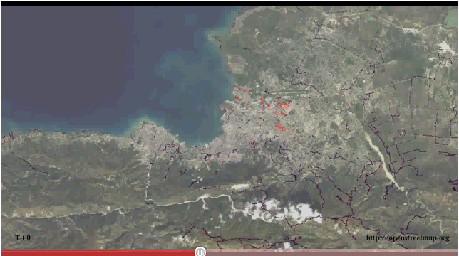
Haiti Earthquake, January 2010

Slide 66
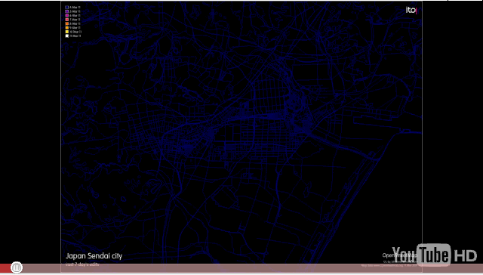
Sendai Earthquake & Tsunami 2011

Slide 67
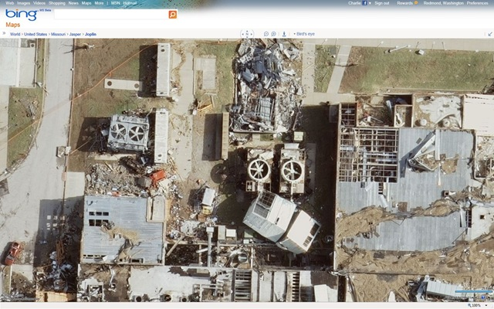
Post-disaster Bing Imagery for tracing
Joplin, MO 2011

Slide 68
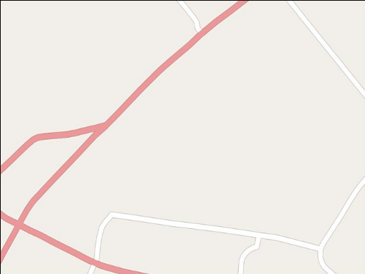
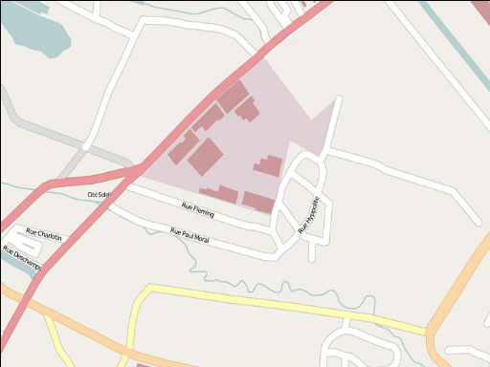


Post-earthquake Mapping in Port-au-Prince
Source: http://www.harrywood.co.uk/blog/

Slide 69
Authority and Trust
OSM is Authoritative…but authority is decentralized
Based on authority of the community that maintains data
Is not derived from mandate from central organization
Currency is vastly improved over traditional methods of updating
To what extent is currency a differentiator for accuracy?
But currency != quality

Slide 70
What is this level of response worth?
In lives saved?
In response and recovery time?
To the social fabric of your community?
To your local economy and businesses?

Slide 71
How You Can Get Involved
Creating a community of mappers

Slide 72
What is the purpose?
Partnering with citizen mappers for…
Response to natural disasters and hazards
Collecting features beyond your reach
Taking collective ownership of community geospatial data
This is where you come in…

Slide 73
Three things you can do
Become an OpenStreetMap contributor
Help Improve Addresses in OpenStreetMap
Contribute to Safe Routes to School Project

Slide 74
1. Become and OpenStreetMap Contributor
Start mapping, in your neighborhood
Organize and hold a mapping party
Reach out to youth & civic organizations
Scouts, 4H, Outing clubs, sporting organizations
Students, retirees
Share your data and allow the community to build on it

Slide 75
2. Join the Addressing Project
Worldwide, a big push to add and improve address data quality in OpenStreetMap
Improves routing capabilities
Improves coverage of landmarks and destinations
Need for a North American schema
Efforts have been made on local level
MappingDC has imported data from District of Columbia
Includes building footprints and address data

Slide 76
Improving Address Tagging in OSM
76
For a North American schema:
Use the US Landmark, Thoroughfare, Postal Standard (LTPS) as starting point
A crosswalk between LTPS standard and existing tags has been created
Open for your comments and refinement

Slide 77
Improving Address Tagging in OSM
Project Objectives:
Produce schema for addressing better suited to North American address conventions
Support greater granularity for address data elements
Develop a convention for tagging address context

Slide 78

3. Contribute to Safe Routes to School Project
Support USDOT Safe Routes to School Program
Analyze pedestrian & bicycle access

Slide 79
Safe Routes to School Project Benefits
Increase safety for a vulnerable population
Visibility into the importance of bicycles and pedestrian as transportation
Improve insight into transportation / land use interface

Slide 80
Thank You
Questions?
Steven Johnson
(e) stevejohnson@deloitte.com
(t) @geomantic
This document licensed in entirety by Creative Commons CC-by-SA. For specific terms of license, see: http://creativecommons.org/licenses/by-sa/3.0/

